Slide 1

Dream-A-Scene
Christine Talbot, Kenneth Hall,
Yongkang Liu, Grace Christenbery

Slide 2
Introductions
Christine Talbot – System Designer
Kenneth Hall – Interface Designer
Yongkang Liu – Programmer
Grace Christenbery – Programmer
PROJECT NAME:
Dream-A-Scene
¹

Slide 3
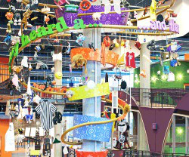
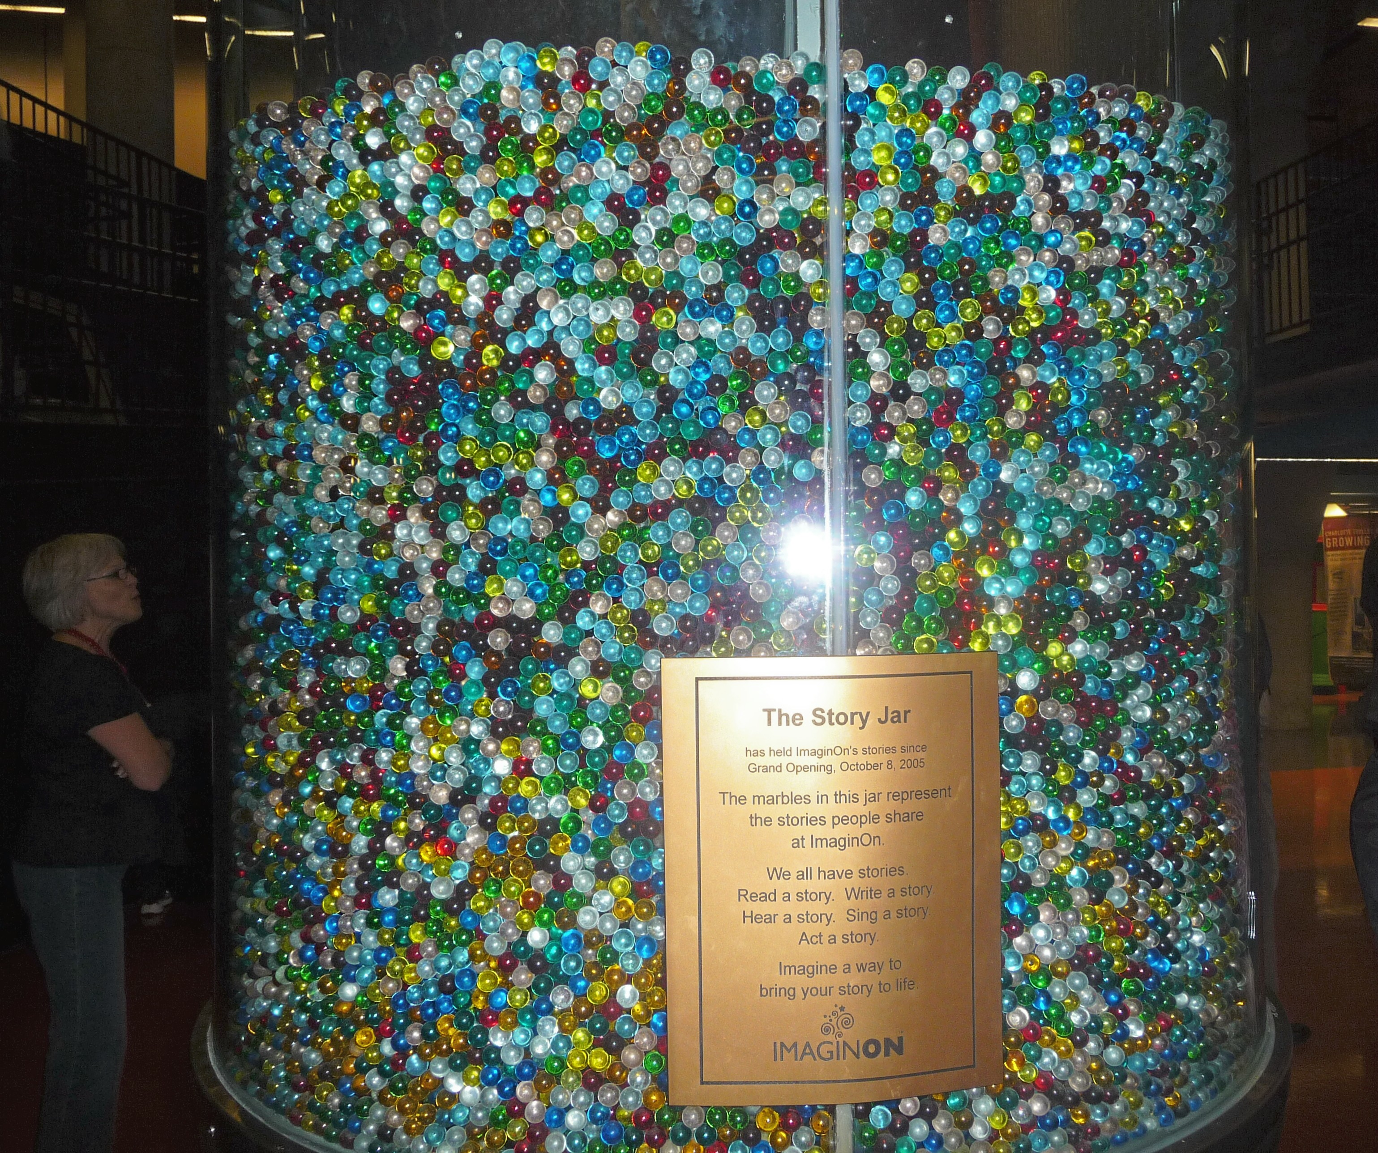
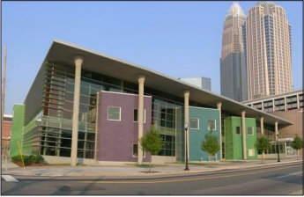
Project Purpose
Microsoft PixelSense Surface
ImgainOn StoryJar Setting
Create Scenes from ClipArt
¹

Slide 4

Key User Groups & Stakeholders
User Groups
Academic Groups
Teachers with Students
Families
Parents with Children
Stakeholders
Museum Administrators
Goals:
Make money from device
Spur more interest in the museum
Application Support
Goals:
Provide an easy interface
Easy to maintain and support
¹

Slide 5
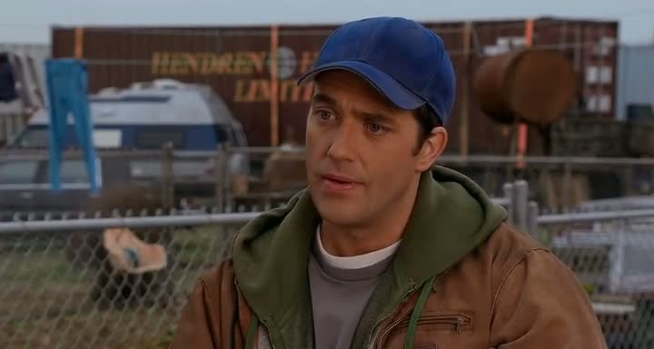
Design Method - Personas
Teacher – Tom Ryan
Average guy who follows the rules
4th Grade teacher, safety a priority for his students
Wants kids to learn and create sentimental values
¹

Slide 6
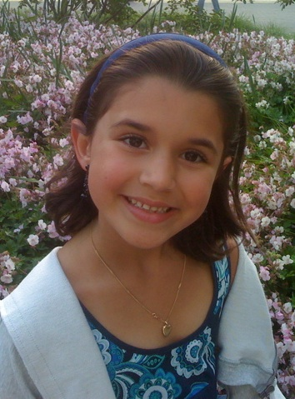
Design Method - Personas
Student – Sally Crocker
8 year old 4th grader
Sally is really shy, but very imaginative
Likes to work on things by herself
Perfectionist
Wants her parents to be proud
¹

Slide 7
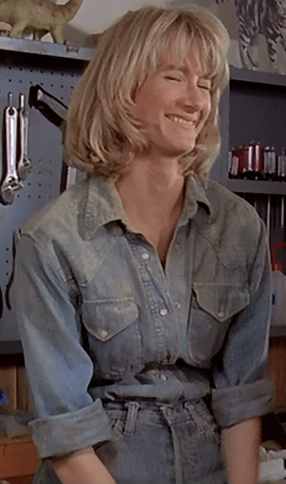
Design Method - Personas
Parent – Jan Davis
Hard working mother of two
She loves and worries about her kids a lot
Wants to ensure her kids are learning
Strong family values
¹

Slide 8
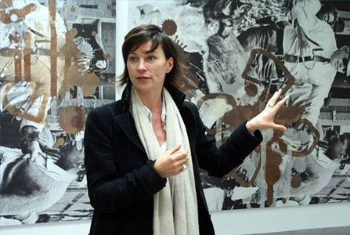
Design Method - Personas
Museum Admin – Marissa Curie
Curator for over 11 years
Wants kids to effectively and efficiently use Dream-A-Scene ensuring a productive environment
Poise and very dedicated to her work
Determined to keep ImaginOn in top shape
¹

Slide 9
Design Method - Observation
Observations of usage of similar collage creators online
Observations of usage with paper prototypes
Observations of usage with soft prototype
¹

Slide 10
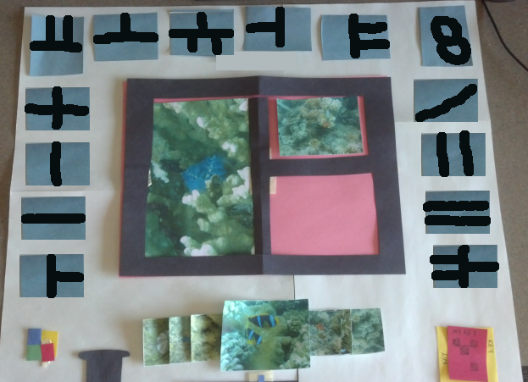
Initial Prototype
Museum Setting
Photo Collages
Concerns:
Too grid-like
Doesn’t encourage
sharing
Ownership of photos
is an issue

Slide 11
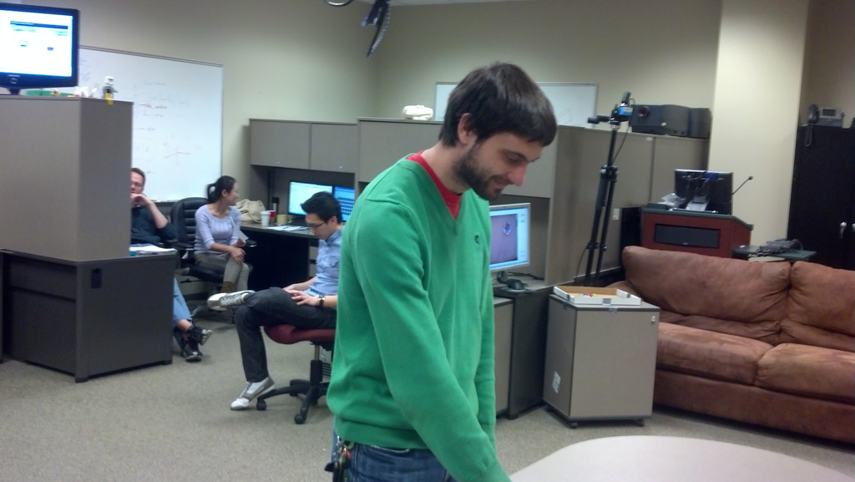
User Studies with Initial Prototype
User Study #1
Cyber Corps lab, two people
Wizard of Oz method
11 suggestions and security flaws regarding personal privacy
User Study #2
Future Computing Lab (FCL) researchers, a group of five people
Wizard of Oz method
14 suggestions
Both focused on technically-savvy users
¹

Slide 12
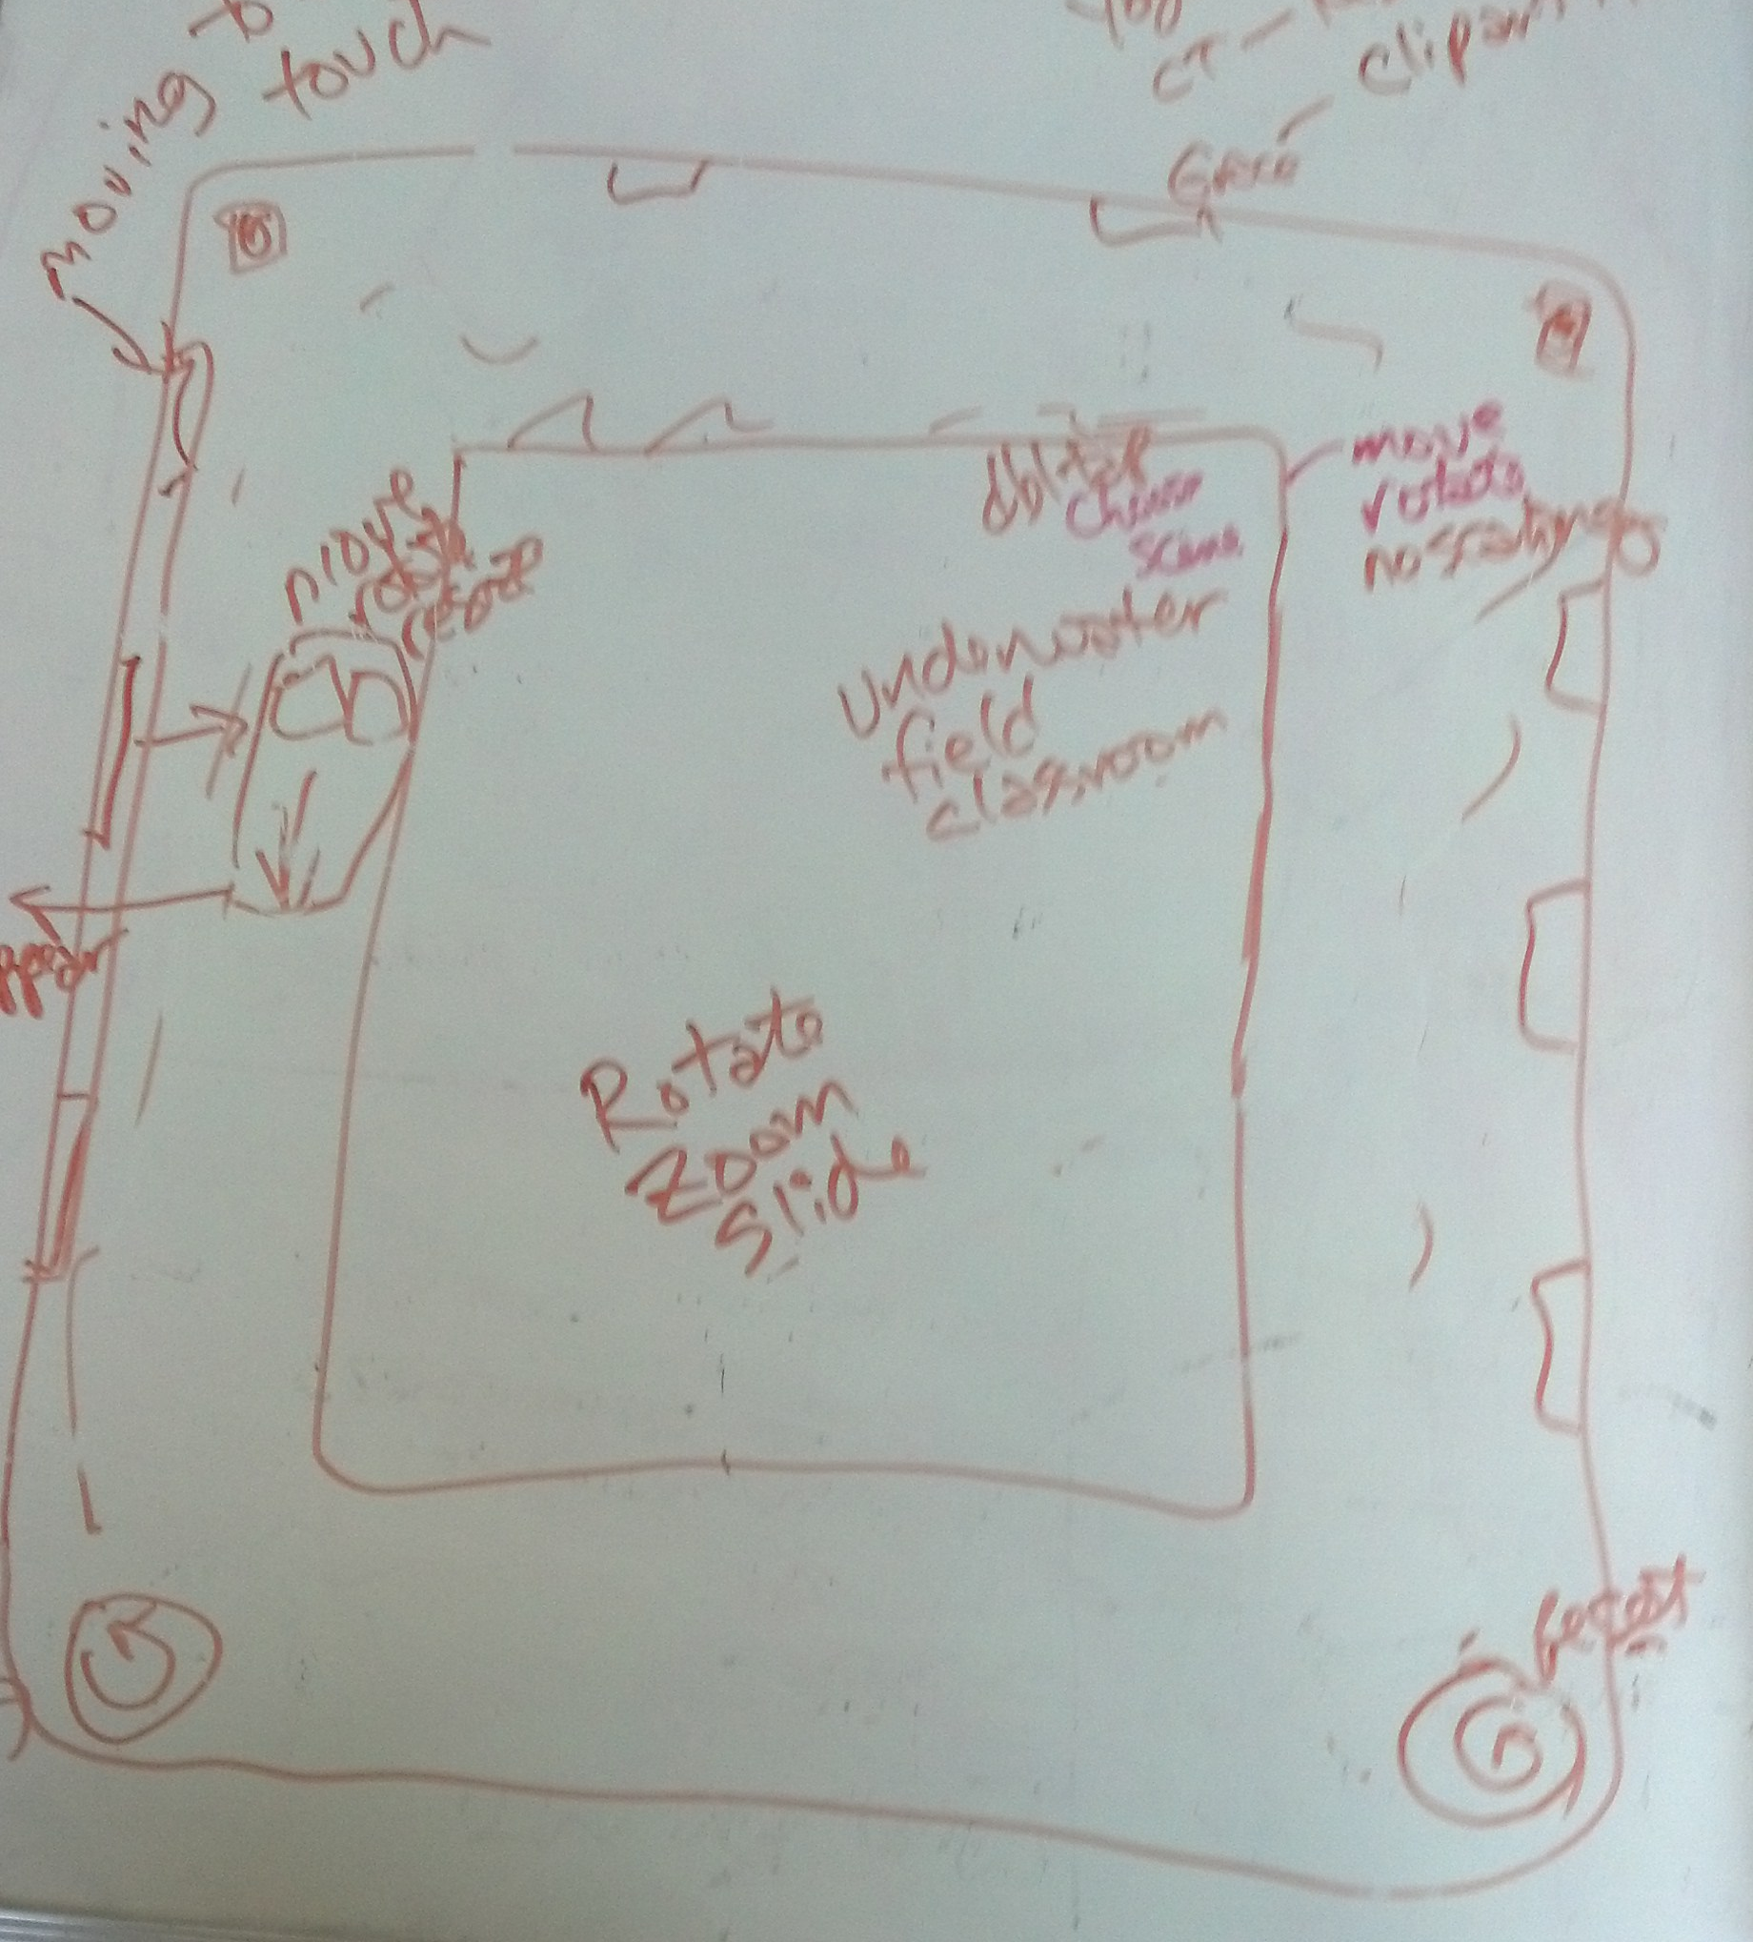
Re-Designed Prototype
ImaginOn’s Story Jar setting
Children-focused
Scene creation
Key Features:
Central moveable workspace with background
ClipArt moveable “menus” around edges
Ability to drag ClipArt onto scene
Rotate, Zoom, Move
Ability to change scenes
Ability to reset scene

Slide 13
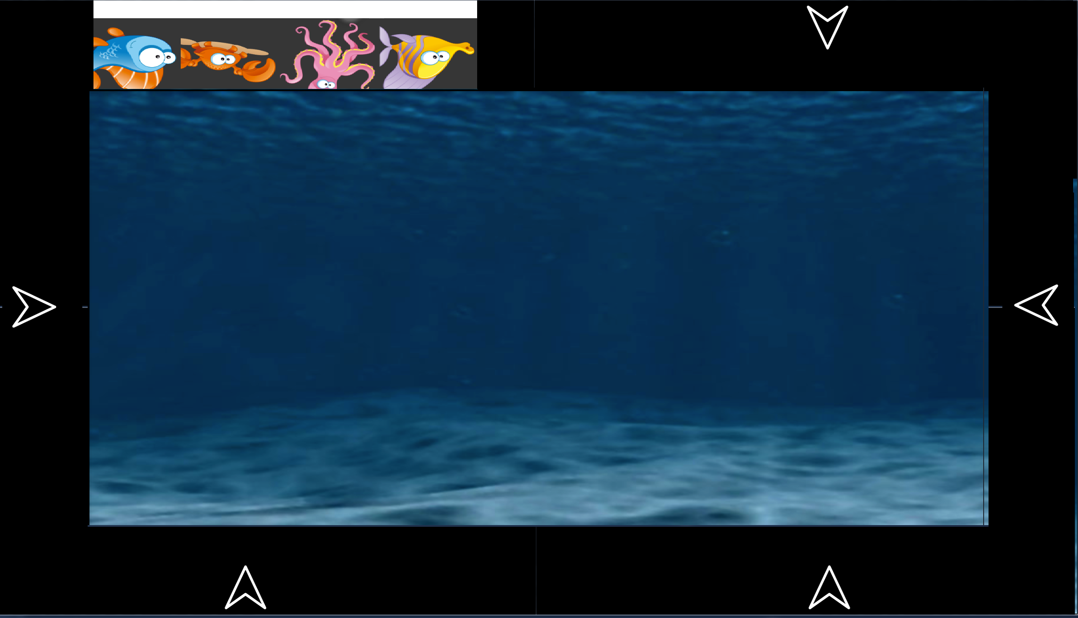
Adjustment of Design
Docking of ClipArt windows
Menu option for background changes
Join button feature
Six ClipArt areas
¹

Slide 14

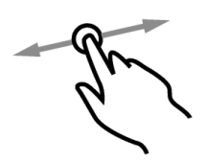
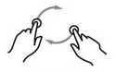

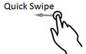
Gesture Usages
Touch
Menu
Join Feature
Drag
Create
Remove
Rotate
Resize
Flick

Slide 15
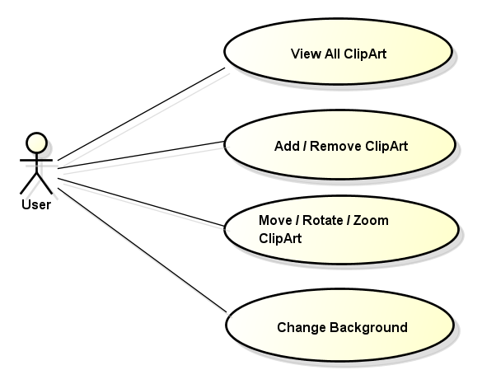
System Design
User Case

Slide 16
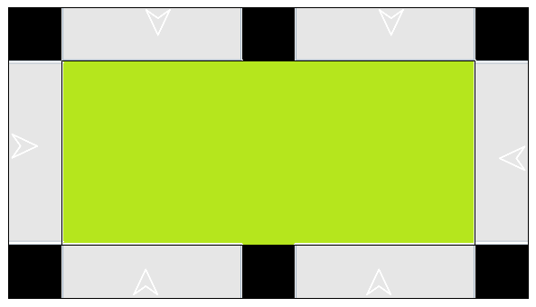
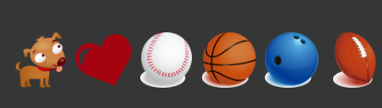
System Design
Major Objects:
Grid Layout for Screen Placeholders
ClipArt Library Bar

Slide 17
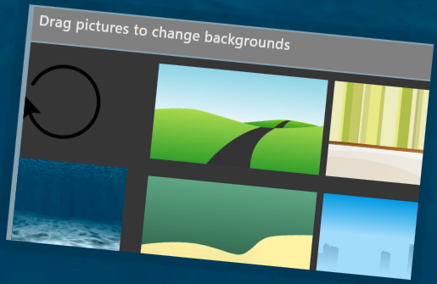
System Design
Major Objects:
Context Menu for Background area
Drag/Drop Functions

Slide 18
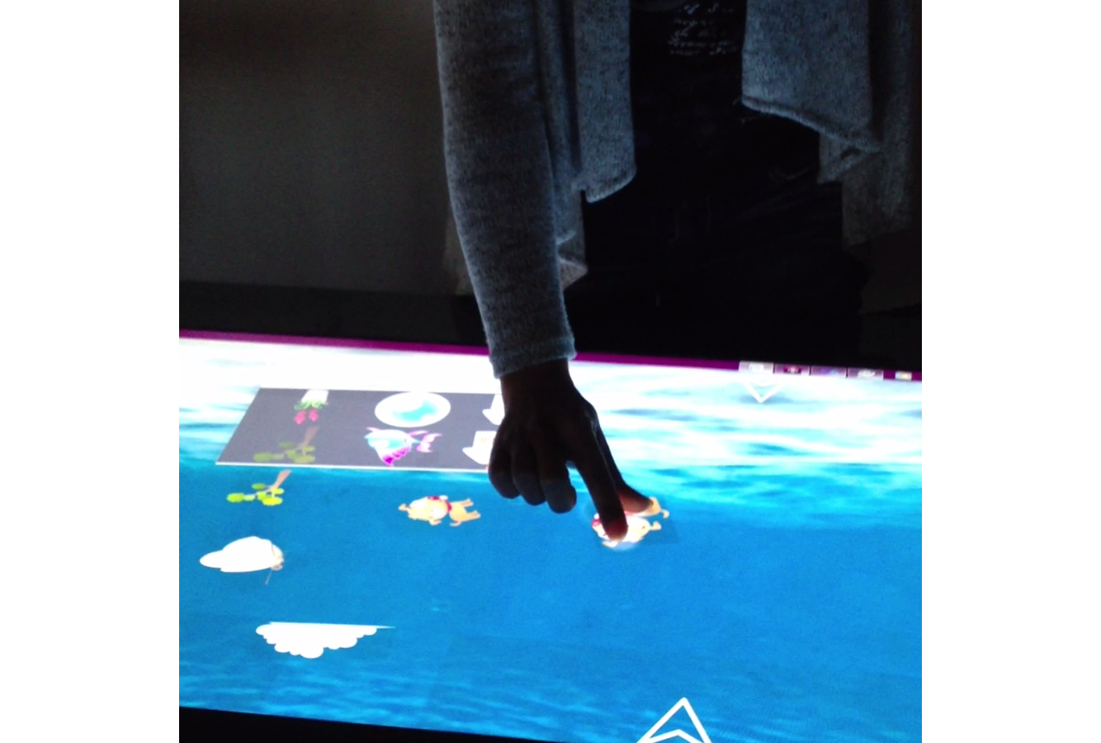
User Evaluation

Slide 19
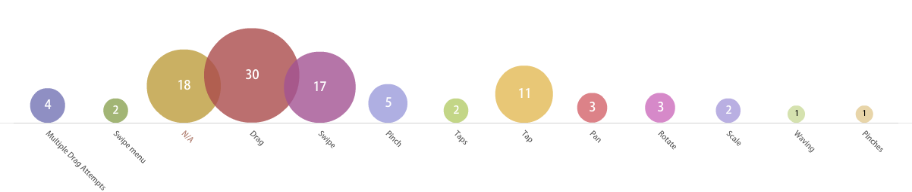
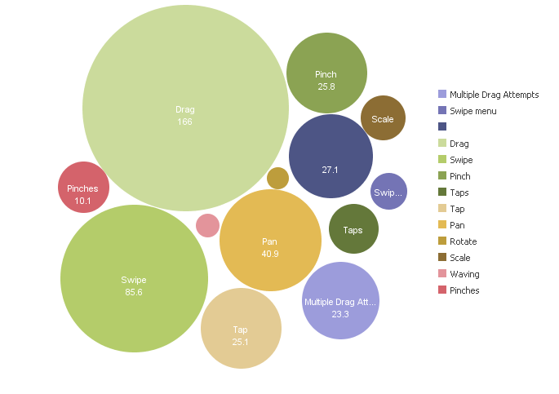
Gesture Analysis

Slide 20
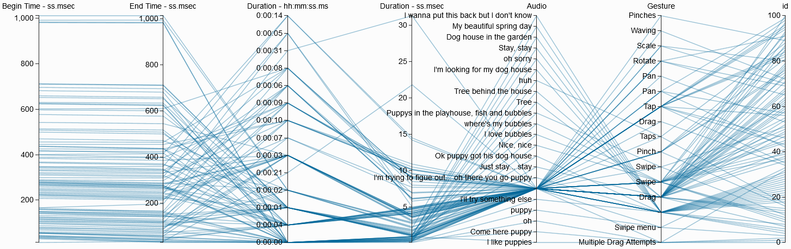
Gesture Analysis

Slide 21
DEMO

Slide 22
Questions?
Notes:
Thank you! – Any questions?

